Slide 1
Psychometrics: Exam Analysis
David Hope
david.hope@ed.ac.uk

Slide 2
Background
Our exams are information
How much information is in a given exam?
Or a given question?
How can we get more information from our assessment?
How can we ensure our information is correct?

Slide 3
Questions for Psychometrics
What does the exam tell us about our students?
Was the exam well designed?
Do the questions ‘work’?
Can we separate the good candidates from the bad?
How do we know when to drop or change our questions?

Slide 4
More Questions
Is it fair to sum up candidate performance with a single number?
How many areas of ability are being tested?
Can students compensate by being brilliant on one domain – while being unsatisfactory on another?

Slide 5
Assessment in undergraduate medical education: advice supplementary to Tomorrow’s Doctors (2009)
Emphasizes the need for regular psychometric analysis
Requests key statistics on reliability
Nearly all the suggested statistics require variability in student performance
Recent GMC reports on medical schools show their willingness to intervene if psychometric analyses show problems

Slide 6
Exam Analysis
A step by step look at all key exam variables
Problem questions are always highlighted in reports
Suggestions of how to improve the exam’s psychometric performance are included

Slide 7
Distribution of Scores
The shape of the distribution is very informative
  Are candidates clumped together, or widely separated?
  Are failing students separated from the main body of students?
  Nearly all the statistics emphasised as important by

Slide 8
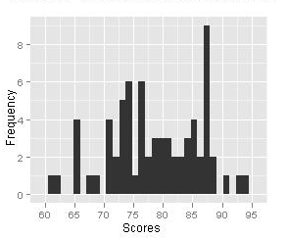
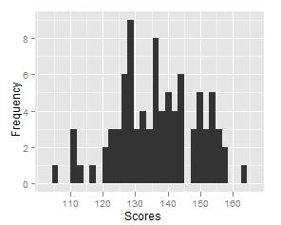
Frequencies
These plots provide information on how many candidates achieved a given score. Note that in both cases a small number of candidates have achieved very high or low marks that separate them from the rest of the group

Slide 9
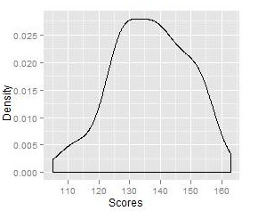
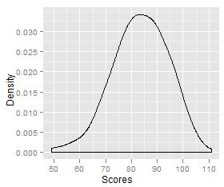
Density Plot
These plots provide the same information as the frequency plots , but as a single smooth shape that is easier to interpret.

Slide 10
Key statistics
Mean
  The mean is a measure of central tendency (the sum of scores divided by the number of scores)
  A high mean indicates most candidates performed well on the exam or item
Median
  The score or case separating the bottom and top half of the scores
  The median (unlike the mean) is not heavily influenced by a small number of significant outliers

Slide 11
Key statistics – Exam interpretation
Mean
  The mean is a very useful indicator of difficulty
  Did candidates perform better than expected?
  Or did they struggle on items predicted to be easy?
Median
  When there are lots of outliers the median may be more useful than the mean

Slide 12
Key Statistics
Standard Deviation (SD)
  A measure of dispersion
  A high SD indicates greater dispersal around the mean
Range
  A measure of dispersion
  Calculated by subtracting the lowest score from the highest score
Min & Max
  The lowest and highest scores in the exam respectively

Slide 13
Key Statistics – Exam interpretation
Standard Deviation
  Where this is low candidate performance is very homogenous
  This will likely cause many problems
  A high SD is useful
Range
  Similar to SD
  Less useful as it is heavily influenced by outliers
Min/Max
  Establishes how your best and worst performers did
  What is the exam ‘floor’?

Slide 14
Cronbach’s alpha
A measure of internal consistency
  Are the questions on the exam testing the same area?
  Typically we want the number to be in excess of 0.7
Many have criticized this statistic with good reason – but it remains commonly used
External bodies often evaluate exams this way – and some will require improvement where the statistic is poor

Slide 15
Key statistic – Exam interpretation
Cronbach’s alpha
  Where the number is low (< .7 and even more so <.6) this indicates exam wide problems and a lack of consistency
  Where the number is very high (>.9) this indicates the exam has oversampled from a single domain
  Evaluating the individual questions is the best solution if the value is problematic
  Low variability is a major cause of problems with alpha

Slide 16
Discrimination
Exams are intended to discriminate
  Will the question separate the good from the bad?
  Discrimination measures the capacity for an item to distinguish between high and low performers on a test
  Items which do not discriminate well are not helping us determine candidate performance
Notes:
This may indicate high levels of guess work, a distractor that is especially appealing to the more capable candidates, or in some cases a miscoded response

Slide 17
Discrimination
Higher numbers are better
  A NEGATIVE number is especially worrisome
  This means it discriminates in the wrong direction
  Candidates who do well overall perform worse at this question
  Values worse than -0.1 usually indicate a serious problem with the question

Slide 18
Facility
Facility indicates the proportion of candidates who got the question correct
Requires interpretation for multi-mark questions
It is always worth looking at those questions which have very high or very low facility

Slide 19
Item-total correlation
Scores on a question are correlated with exam scores
  Higher values mean the candidates who do well at this question do well overall
  When values are close to zero the question tells us nothing about overall performance
  When values are NEGATIVE this means candidates who do well on this question do badly overall

Slide 20
Summarizing group performance
We divide all candidates into four ability groups and rank them from worst to best
Ideally there should be a steady increase in score from the worst to the best group
If this does not occur there is likely a problem in the question

Slide 21
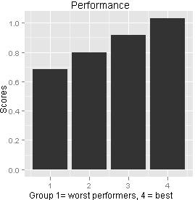
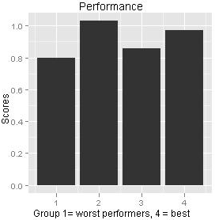
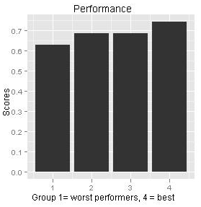
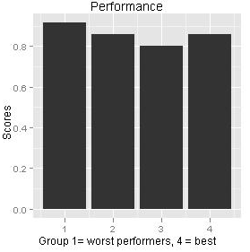
Testing Group Performance
Notes:
The candidates are grouped by ability. Top left: the highest performing group performs best. Top right: no clear trend. Bottom left: a weak positive trend. Bottom right: the lowest performing group performs best. This is a cause for concern.

Slide 22
Responses
It is usually helpful to review what option candidates chose
Ideally candidates who got the question wrong should be evenly distributed among all the incorrect distractor questions
In practice this is rare
BUT looking at the most popular distractors can provide information on why candidates answered in this way
If most candidates pick the same (wrong) answer this suggests a misconception or even a miscoding

Slide 23
Common Problems with Assessment
Most assessment items rely on variability for many of these statistics
Low internal consistency is usually the biggest issue
Low discrimination or low item-total correlations indicate poorly performing questions
Questions where every candidate scores 100% can reduce the effectiveness of the exam
It is very common in our exams for a large proportion of the paper to have 20% or more questions answered correctly by over 90% of an (often 250 strong) student body

Slide 24
New Routine Analysis
Considerably shorter (generally less than 10 pages as opposed to over 100)
Easily searchable
Highlights good as well as bad questions
Retains the same information as the earlier version

Slide 25
Summary
Page provides a histogram and density plot of scores along with key statistics about the exam
The Cronbach’s alpha is especially important

Slide 26
Exam Analysis
This provides key statistics on each question
Problematic items are highlighted
By using the ‘filter’ buttons (the arrows on the first row) you can sort smallest to largest or largest to smallest
This allows you to look at the best questions as well as the worst
You can also search for keywords and so bring up only questions from a particular section of the exam

Slide 27
Responses
This lists the options selected by the candidates
It provides the number of questions (variables) and students (observations)
Each question is named and appears in order
‘n’ is the total, missing is the number of missing cases, and unique is how many options were chosen
The next set of numbers gives the option, followed by the raw number and percentage in brackets
For the first question in this example 4 people selected 0 (6%) while 66 people selected 1 (94%)

Slide 28
Post-exam support
I can provide support in revising questions, interpreting examination scores and assessing the key statistics
I attend post-exam assessment panels and exam boards and can attend any informal meeting to review exam performance
If there are specific things not in a report you would like to see done this can be arranged

