Slide 1
Writing MCQs in Clinical Education & OSCA Training
Dr David Hope
Psychometrician
University of Edinburgh
David.hope@ed.ac.uk

Slide 2
Learning Outcomes
Boost confidence at writing MCQs
Streamline MCQ writing process
Discuss quality control

Slide 3
Why are MCQs useful?
Time and cost effective
Test important domains
Tough testing in a safe environment
Excellent sampling – reliable results
Correlates with clinical tests and practice

Slide 4
Single Best Answer
Best of 3/4/5
Single Best Answer or Extended Matching

Slide 5
Getting Started
1. Begin, consult, and end with learning outcomes
2. Draw up assessment blueprints
Consider themes, subjects, clinical context
Consider cognitive skills
3. Exam analysis
Ask ex-students
Use writing parties
4. Be experimental and enquiry–led (use your results)

Slide 6
Blueprinting an Exam

Slide 7
Blueprinting a Theme (MCQs on Prescribing)
 | Cognitive Skills Knowledge/Comprehension/Application/Analysis/Synthesis/Evaluation
 | First line drugs | Monitoring |  | Mechanisms of action |  | Side-effects Interactions
MCQs Dec | R /CVS /GI | LMS Chemo |  | GI/Chemo |  | Chemo Opioids LMS
Dec FBACK | Whole class discussion of strengths and weaknesses
MCQ June | LMS Chemo |  | R /CVS |  | Opioids LMS |  | Neuro CVS

Slide 8
Cognitive Skills to Test in MCQs
Knowledge – list, define, identify, describe
Comprehension – summarise, describe, predict
Application – apply, calculate, illustrate, solve, classify
Analysis – analyse, explain, compare, infer, classify
Synthesis – integrate, plan, create, what if?, generalise,
Evaluation – assess, decide, recommend, judge, explain, diagnose, investigate, manage

Slide 9
Summary: Good Questions
SCENARIO
Set in authentic contexts
Good range of LOs/topics/contexts
More weight to more important LOs/topics
Tests range of relevant cognitive skills
Avoids abbreviations & gives normal ranges of results
Structure: consider length, avoid flaws
Content: consider use of difficult primary information or immaterial facts
Ensure non-identifiable data

Slide 10
Summary: Good Questions
LEAD-IN TASK/QUESTION
‘What is the most likely diagnosis?’
  not the ONLY correct diagnosis
Question can stand alone
  e.g. cover the options
Should not pose more than one problem (though question may have several steps)

Slide 11
Summary: Good Questions
Options
Should be homogeneous & short
The BEST (keyed-answer) must
be widely agreed
Plausible and familiar to students
Similar in style and length
Grammatically correct & follow on from the lead-in question
List in order e.g. numerically or alphabetically

Slide 12
Example Question (examples taken from Case and Swanson 2008)
S T E M
46yr old woman presents with 48hr of RUQ pain, nausea and vomiting. O/E her temp is 38°C. Blood tests show WCC 12.7; Bilirubin 68micromoles per L, AST 137U/L, Alk Phos 421U/L, GGT 299U/L
The most likely diagnosis is:
Acute pancreatitis (DISTR)
Acute viral hepatitis (DISTR)
Ascending cholangitis (KEYED ANSWER)
Haemolytic hyperbilirubinaemia (DISTR)
Drug reaction with cholestatic jaundice (DISTR)
OPTIONS

Slide 13
Steps to Create SBA Questions
CHOOSE THEME/TOPIC – “Anatomy of the hand”
TASK/QUESTION – “Application of knowledge: Identify anatomical problem from clinical problem”
WRITE SCENARIO – “Man with swan neck deformity”
  OPTIONS:
1. Subluxation flexor digitorum profundus tendons
2. Subluxation flexor digitorum superficialis tendons
3. Plausible alternatives from student misconceptions

Slide 14
Variations on a Theme
CHOOSE THEME/TOPIC – “Anatomy of the hand”
TASK/QUESTION – “Application of knowledge: Identify the most likely nerve damage from the clinical problem”
Write SCENARIO – “Man unable to hold card between thumb and palm”
  OPTIONS:
1. Ulnar nerve
2. Median nerve
3. Etc

Slide 15
- Other Themes -
CHOOSE THEME/TOPIC – “Pathology”
TASK/QUESTION – “What is the most likely findings at autopsy / biopsy?”
Write SCENARIO – “Man with chest pain worse on breathing, fever, ECG (shown)”. Provide relevant limited details and avoid red herrings and traps.
Empirical data is more discriminating.
  OPTIONS:
Inflammation of pleura
Inflammation of pericardium
Thrombus in the left main coronary artery

Slide 16
Extended Matching Questions
SBA questions but with:
Same list of OPTIONS for several SCENARIOS
Scenarios come AFTER the lead-in question e.g:
“From List A choose the most likely diagnosis in each patient. Any diagnosis can be used more than once or not at all.”
List A: Cerebrovascular event, Seizure, Cereballar ataxia, Vitamin B12 deficiency
SCENARIO 1: 52yr woman with a BP of ……
SCENARIO 2: 70yr old man who is ………..

Slide 17
Steps to Create EM Questions
CHOOSE THEME/TOPIC – “Falls”
LEAD-IN QUESTION – “What is the most likely diagnosis in each patient”
OPTIONS – “List of differential diagnoses that students should be able to identify”
SCENARIO – “At least two giving context and scenario”

Slide 18
Test ‘Your’ Own Questions
SCENARIO
Set in authentic contexts
Good range of LOs/topics/contexts
More weight to more important LOs/topics
Tests range of relevant cognitive skills
Avoids abbreviations & gives normal ranges of results
Structure: consider length, avoid flaws
Content: consider use of difficult primary information or immaterial facts
Non-identifiable data and investigations

Slide 19
Test Your Own Questions
Options
should be homogeneous & short
the BEST (keyed-answer) must
be widely agreed
plausible and familiar to students
similar in style and length
grammatically correct & follow on from the lead-in question
list in order e.g. numerically or alphabetically

Slide 20
Then always try out your questions
Try them on learned, critical colleagues
Test them in formative exams
Include some in each summative exam
Check if the wording precise enough
Evaluate whether all the options are working
Review item analysis after the exam

Slide 21
Writing Best Answer Questions
4 Components
THEME/TOPIC/LO: …………………………….
FOLLOW-ON TASK/QUESTION: ………..
SCENARIO: ………………............................
OPTIONS: …………………………………..
Be sure to check that you can offer a sensible answer while covering the options.

Slide 22
Extended Matching Questions
4 Components
THEME/TOPIC/LO: ……………………….
LEAD-IN TASK/QUESTION: …………
OPTIONS: ……………………….............
SCENARIO: ……………………………..
Be sure to check that you can offer a sensible answer
while covering the options.

Slide 23
Further Reading
Useful Reading:
Case and Swanson (1998) Constructing Written Test Questions for the Basic and Clinical Sciences. NBME
http://www.nbme.org
http://www.medbev.umontreal.ca/docimo/DocSource/NBME_MCQ.pdf
Van der Vleuten CPM (1996) The Assessment of Professional Competence: Developments, Research and Practical Implications. Adv Health Sciences Education 1: 41-67, 1996

Slide 24
Using OSCA
David Hope
Assessment Psychometrician
University of Edinburgh david.hope@ed.ac.uk
Notes:
24

Slide 25
Outcomes
Access and use the OSCA system
Explore the different item types available
Understand tagging
Look at an exam in feedback mode

Slide 26
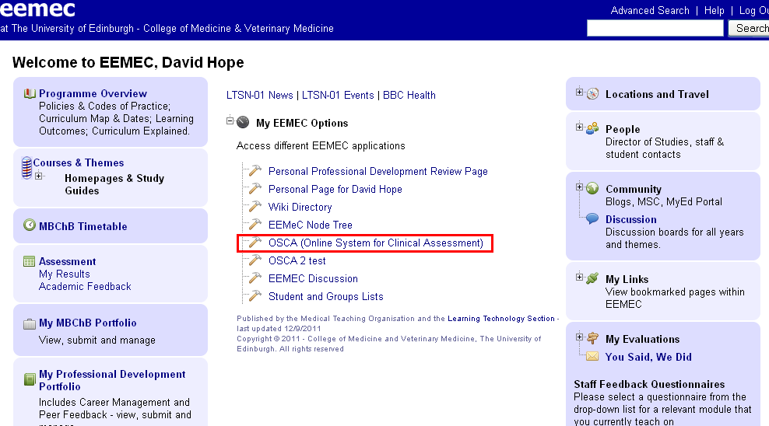
The EEMeC Main Screen: OSCA can be found in the main dropdown menu
Notes:
The Online System may be inaccessible while an exam is taking place. This is to minimize system load – if you cannot access it during exam season this is probably way. Try again after the exam finishes.

Slide 27
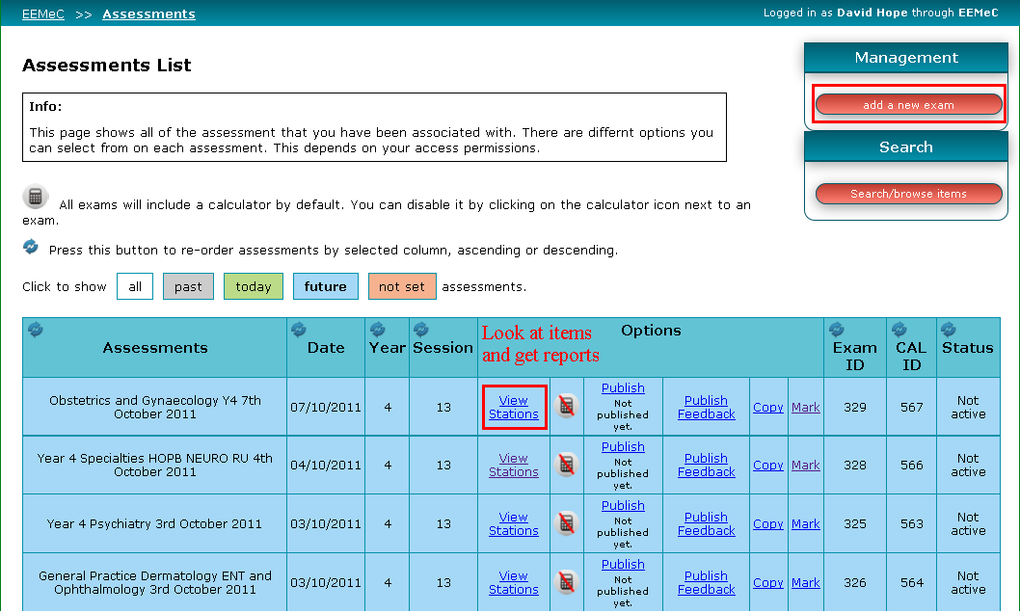
The main assessment list. ‘Add a new exam’ is highlighted. ‘View stations’ is where you look at the exam items.
Notes:
Publish creates a link to the exam. Mark accumulates the marks and records each candidate’s score. Publish feedback creates a new link for feedback mode.

Slide 28
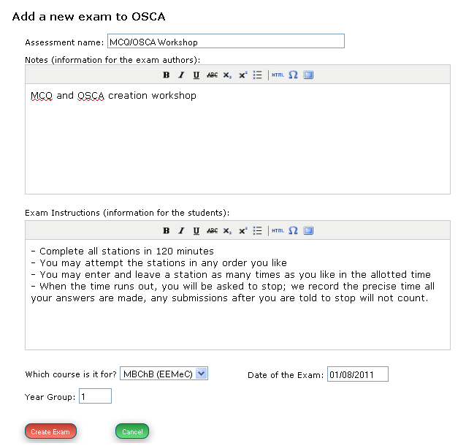
The ‘Add a New Exam Screen’ option. Enter information for authors and students here. Data on the date and year group MUST be selected.
Notes:
Errors may sometimes occur if options are left blank. Fill in all information to avoid this.

Slide 29
Create New Exam
You may not have access to this
Not everyone is responsible for exam creation
If you are only creating QUESTIONS add them to the existing exam you have been given access to

Slide 30
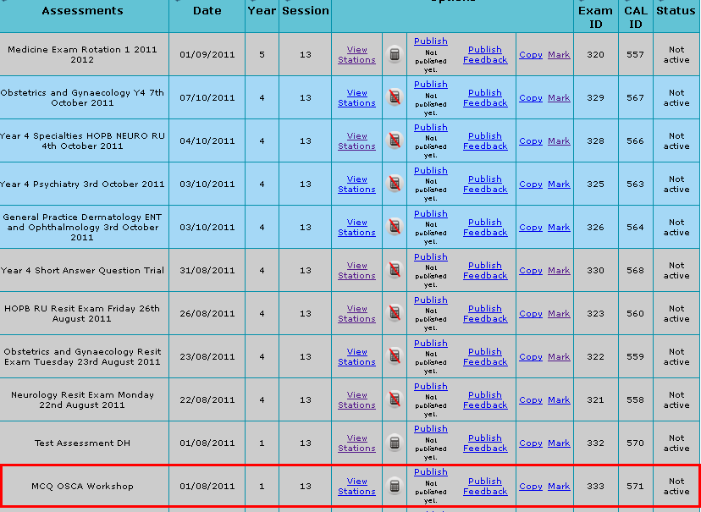
The exam has been added to the main page. We can now view it and add items by clicking on ‘view stations’.
Notes:
Buttons at the top of the page allow you to search for exams that have already been sat, or are in the future.

Slide 31
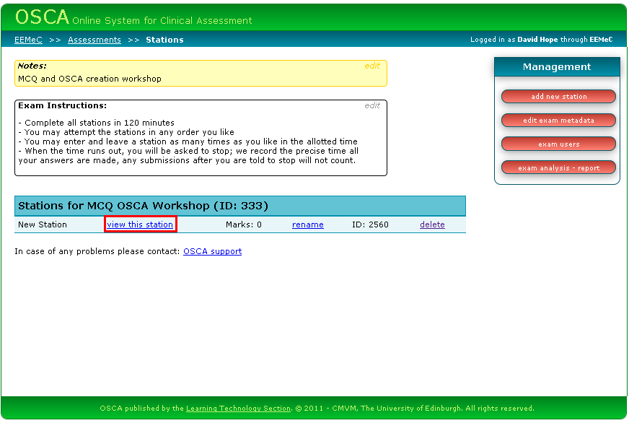
The exam currently has one (empty) station. View it to add or amend items.

Slide 32
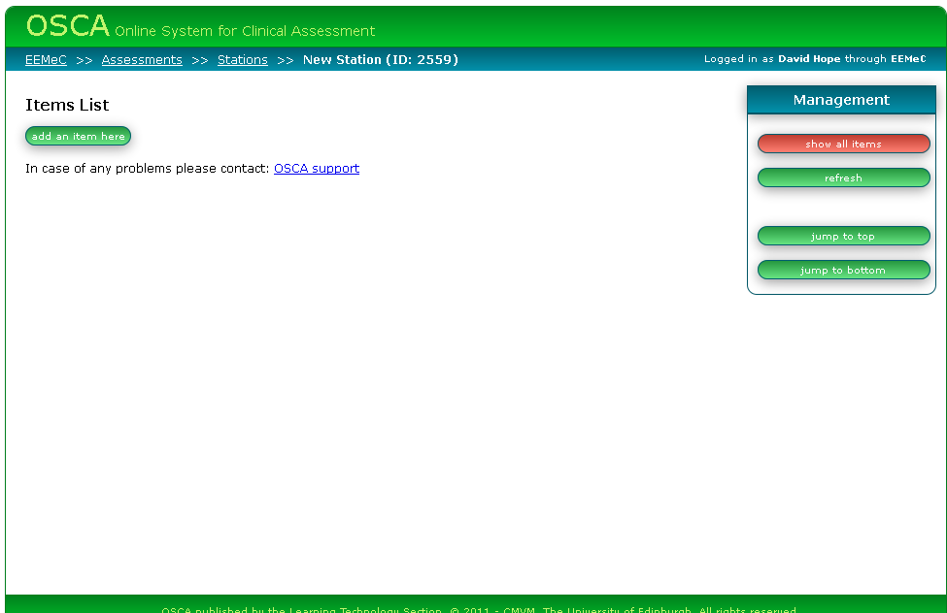
The exam has no items. Click ‘add an item here’ to begin creating the exam items.

Slide 33
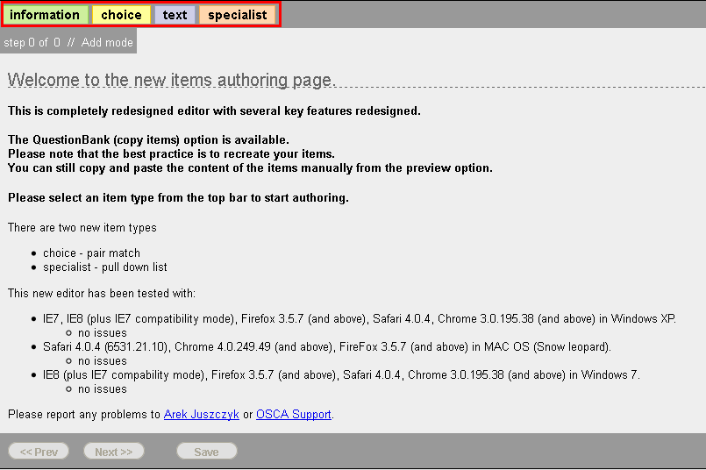
The item authoring page is used for creating a variety of item types. Clicking one of the options in the red box will lead to different item creation wizards. These will now be discussed.
Notes:
If you are having difficulty accessing the exam using a particular browser, contact LTS or OSCA support using the link at the end of this presentation.

Slide 34
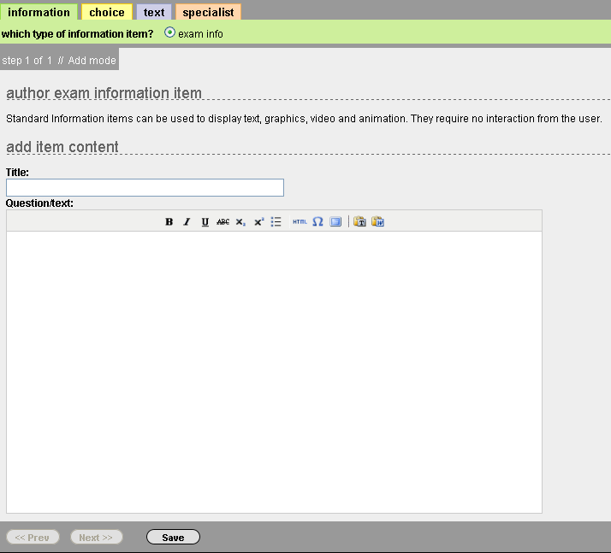
“Information” is not a marked item. It is simply used to provide information or graphics for the whole of the exam.

Slide 35
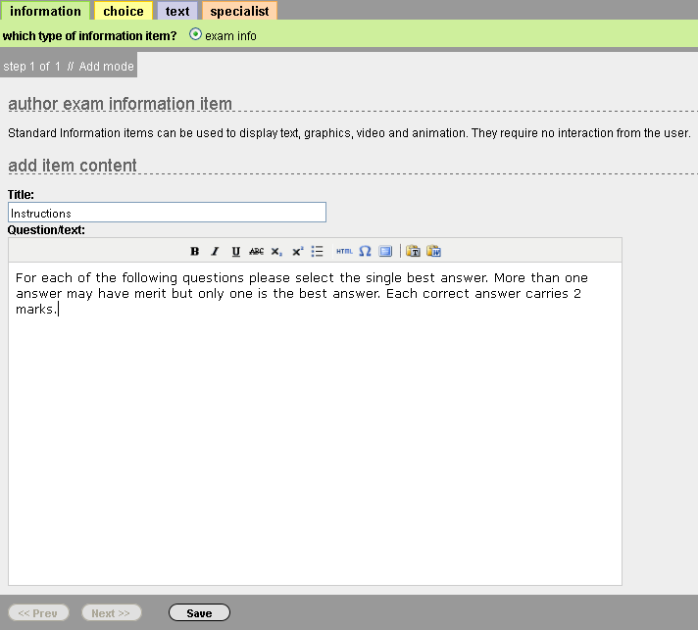
In this case we have provided information on how the rest of the questions should be answered and how many marks for each.

Slide 36
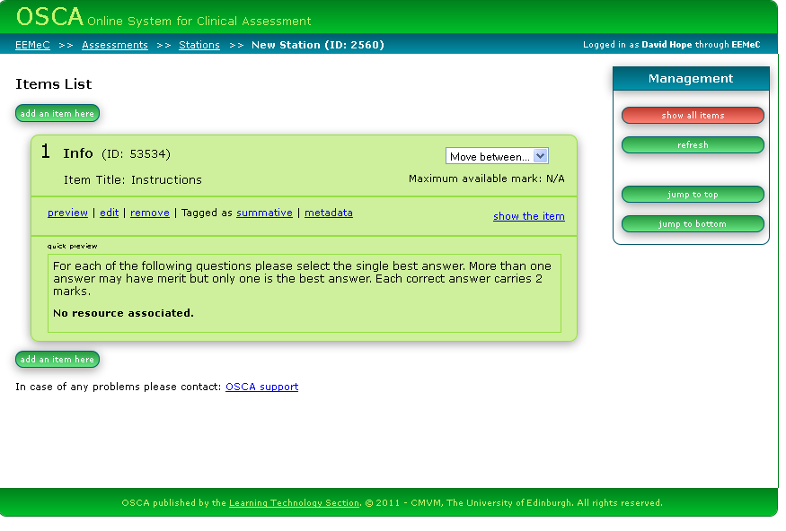
After completion the item can be seen on the main “Items List.” Note we can add items before or after items we have already created.

Slide 37
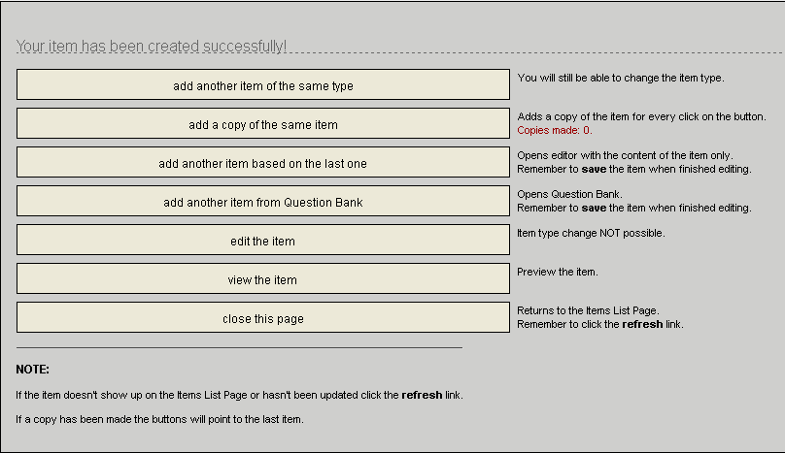
After creating an item a popup window provides shortcuts for your next action. You can also use the options from the main item list if you prefer.

Slide 38
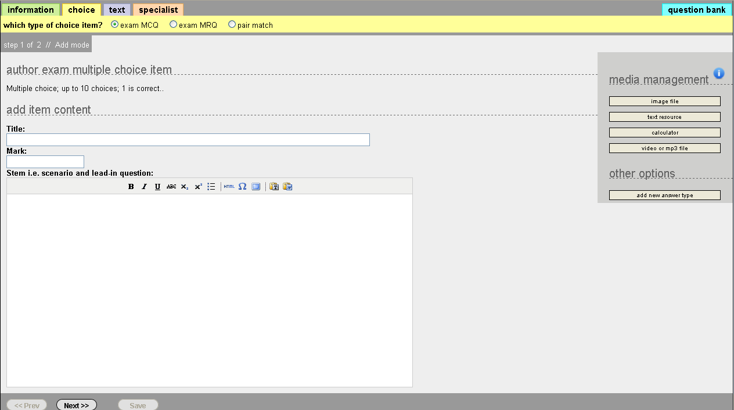
Exam MCQ: Provide a title, mark and lead in question

Slide 39
Images
Uploading an image is straightforward BUT the labelling system does not work consistently
In the meantime label in MS Paint or Photoshop
Use Arial font

Slide 40
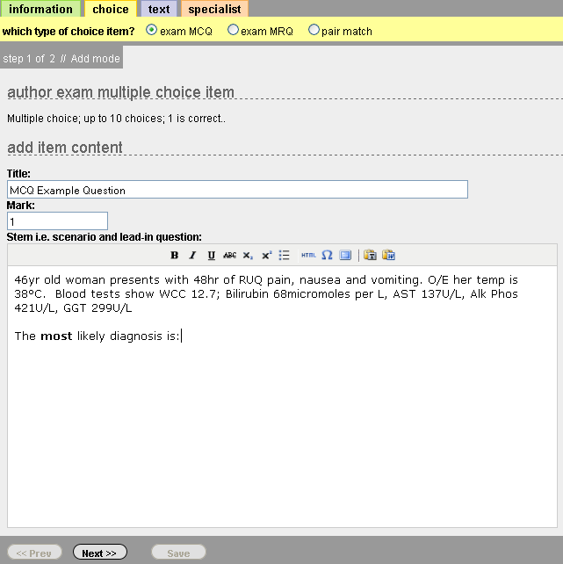
Exam MCQ: An example question worth one mark

Slide 41
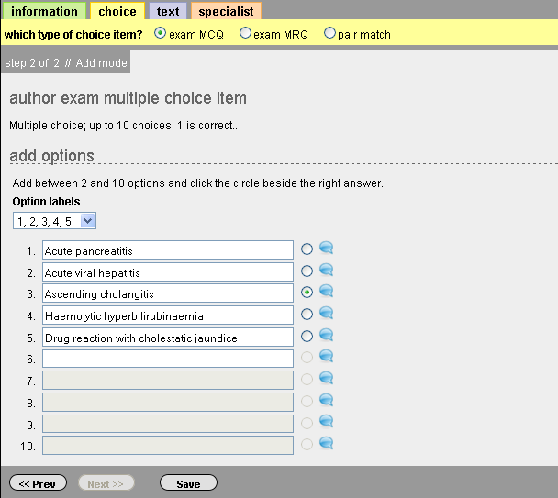
The answers. Vary the presentation via the option labels. The correct answer is marked by selecting the checkbox and feedback is given via the speech bubbles

Slide 42
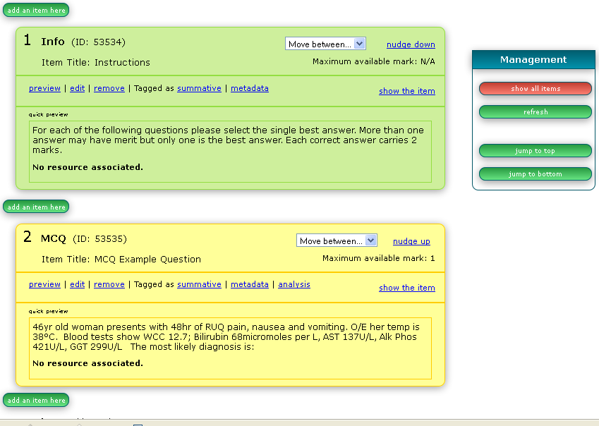
Exam MCQ: The MCQ question has been added to the exam

Slide 43
Metadata
Evaluate QA
Add tags for the item bank
Add programme outcomes
Adding tags allows us to create exams more easily by searching old questions for tags
Tagging is very important and should be done each time an exam item is created
Notes:
A full list of tags can be found in the drop down menus on that screen

Slide 44
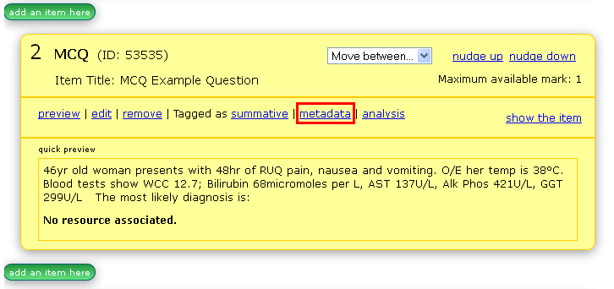

Slide 45
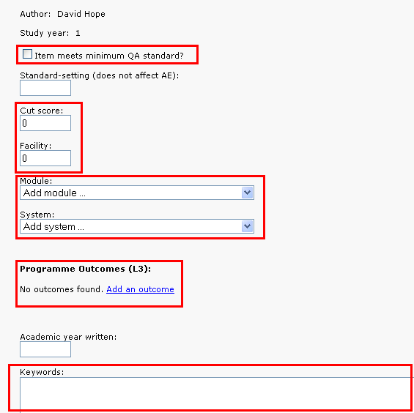

Slide 46
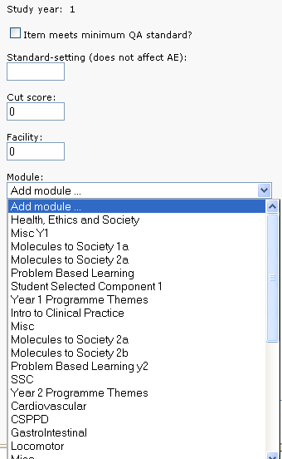

Slide 47
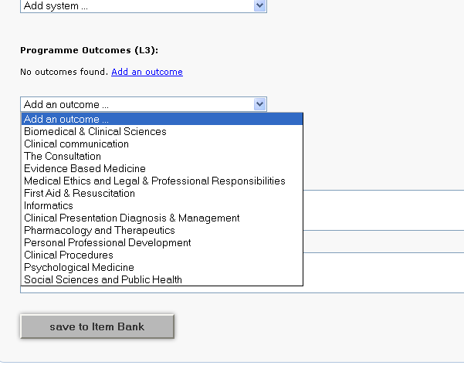

Slide 48
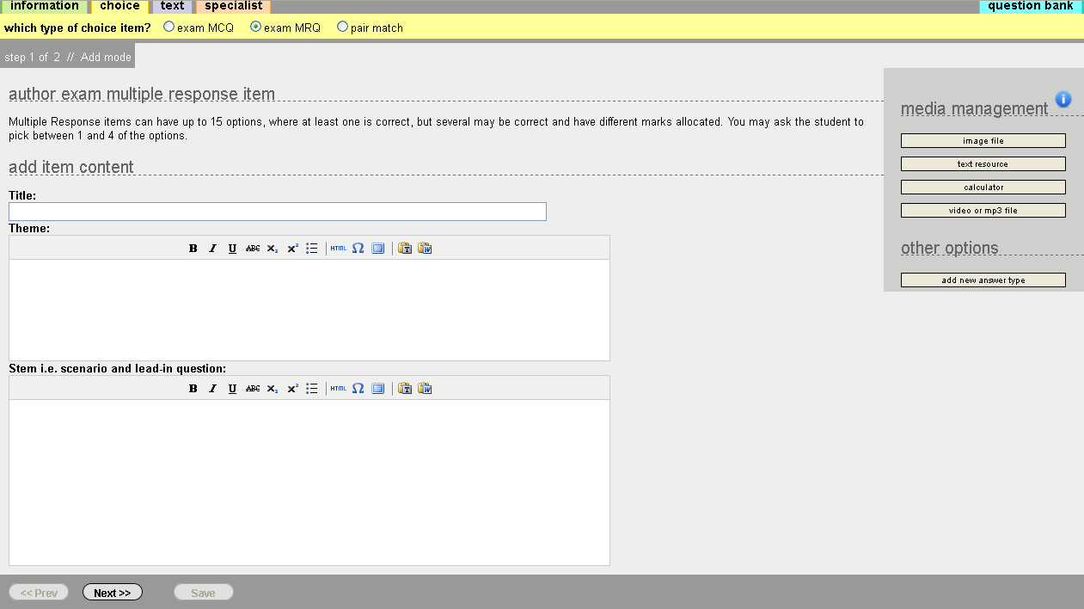
Exam MRQ: Provide a title, theme and scenario

Slide 49
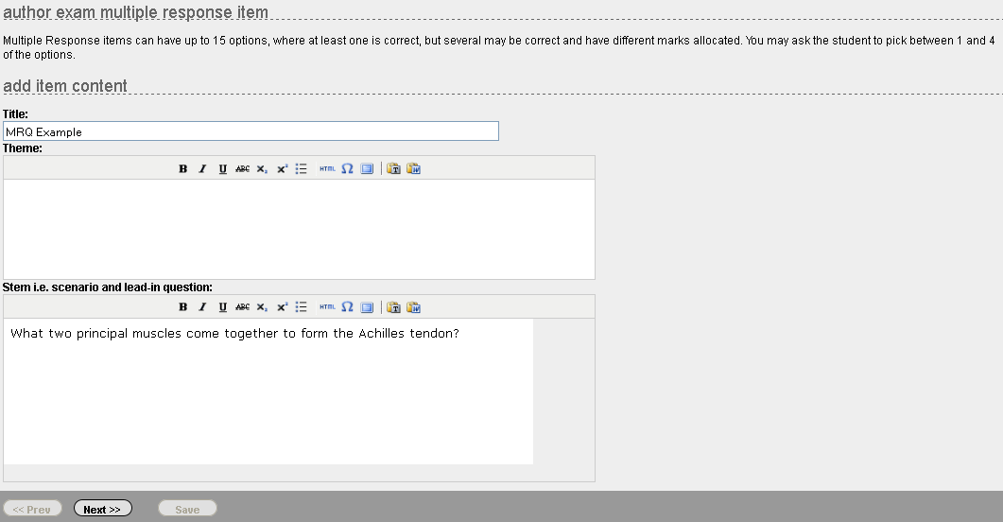
Exam MRQ: An example MRQ question

Slide 50
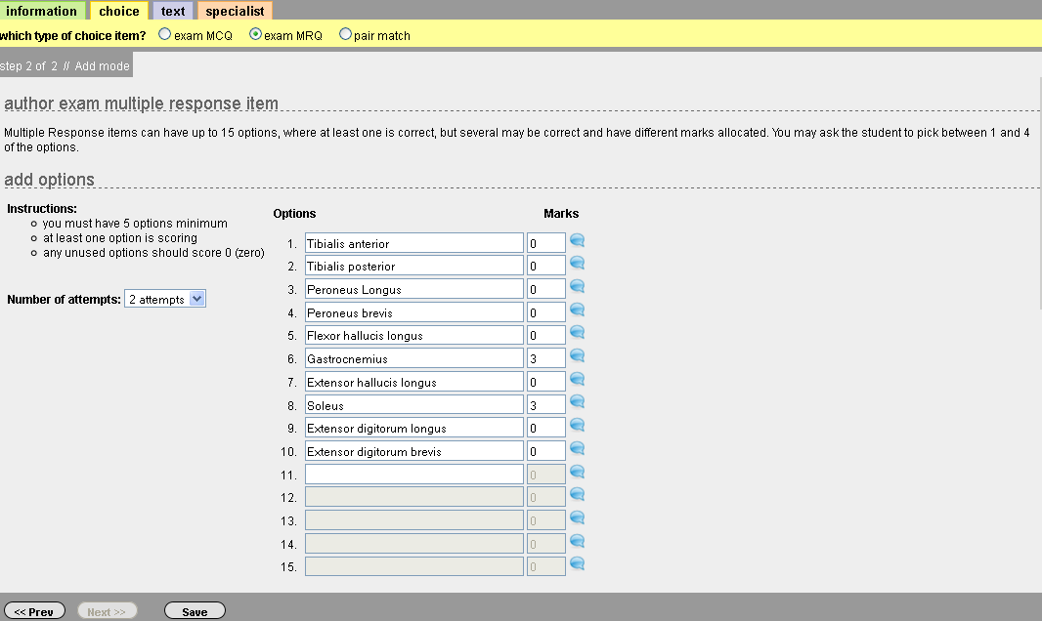
Exam MRQ: The answer list. You may select how many attempts the candidate has and how many marks for each item. Note that unlike the MCQ question multiple items are correct

Slide 51
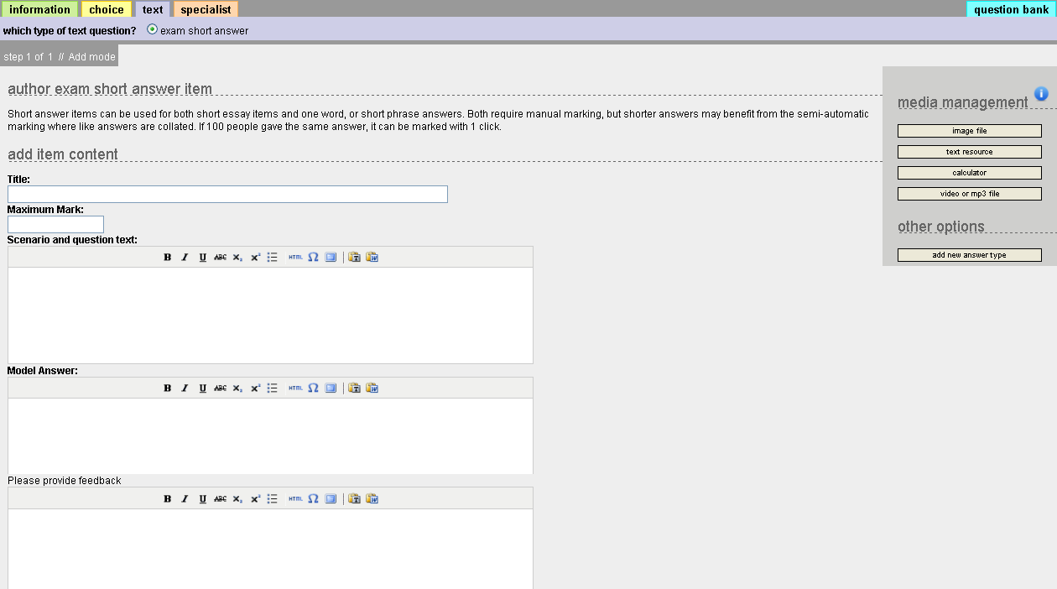
Exam Short Answer. Provide a title, marks, scenario, model answer, and (as necessary) feedback. The candidate response is freeform

Slide 52
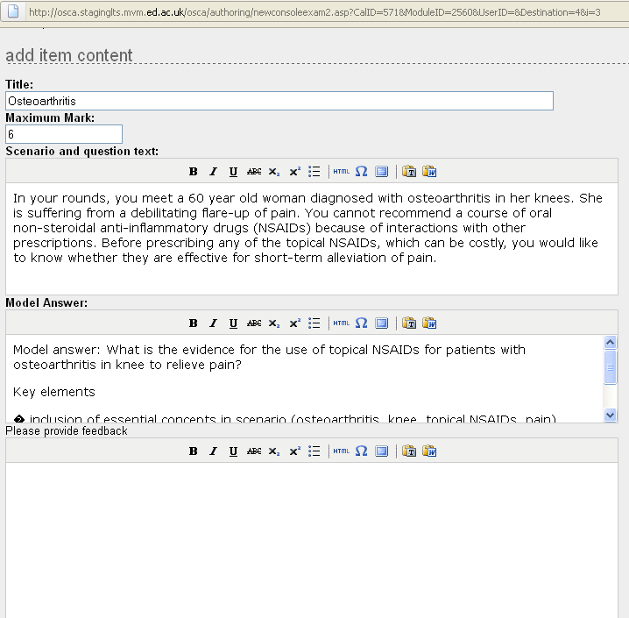
Exam Short Answer. An example scenario and model answer with marks assigned

Slide 53
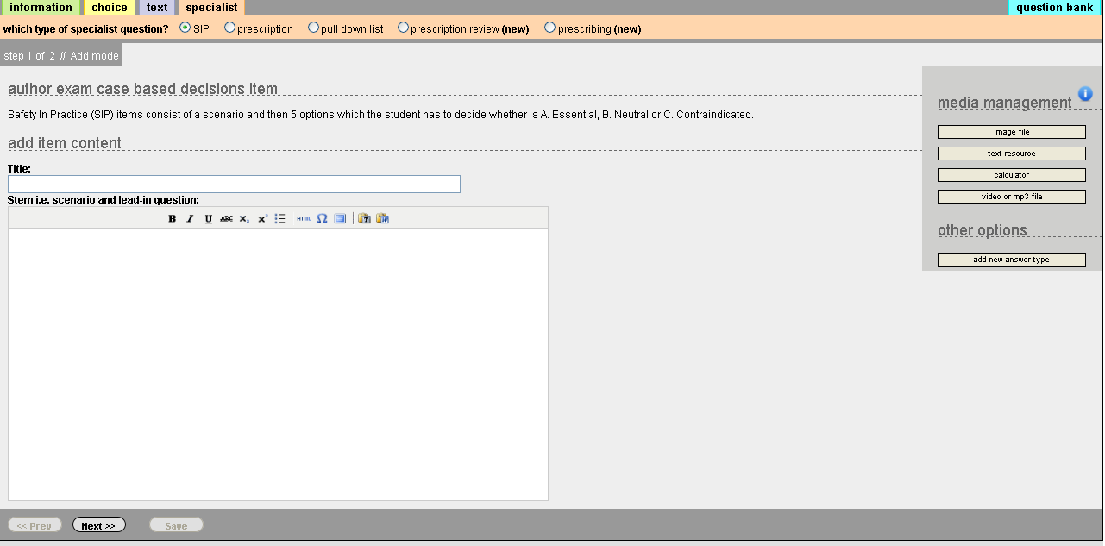
Specialist Types: Case Based Decision Items. Provide a title and scenario

Slide 54
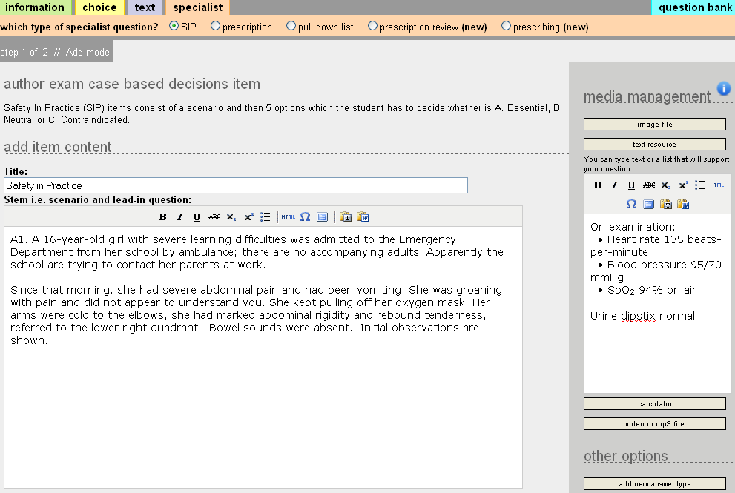
Safety in Practice: Sample Scenario. Note the additional text resource

Slide 55
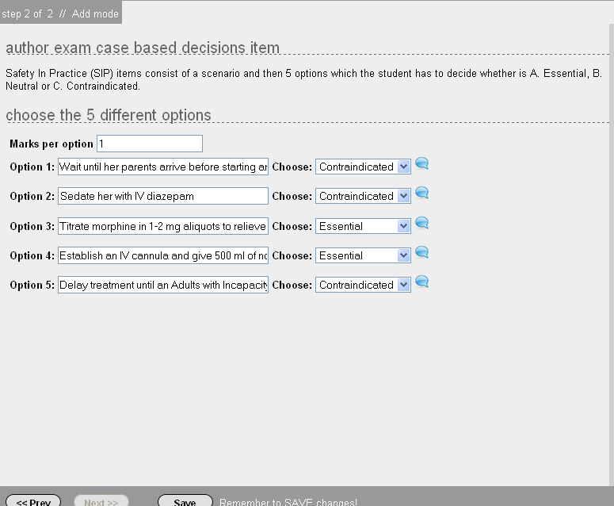
Safety in Practice: Possible answers. Note answers can be essential, neutral, or contraindicated

Slide 56
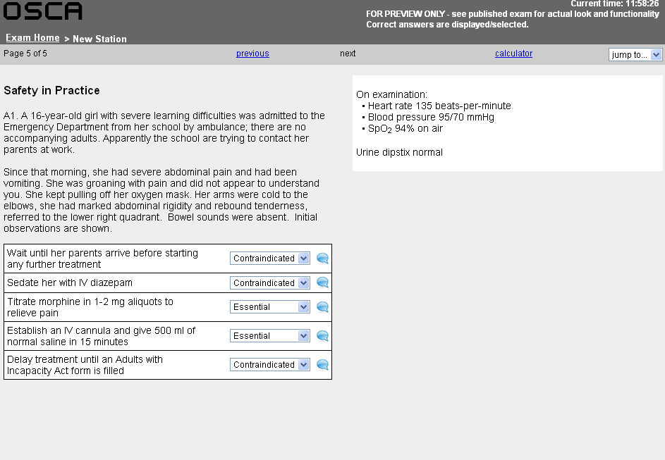
Safety in Practice: This is similar to how the question will look to candidates. Note the ‘text resource’ is presented separately from the main body of the question

Slide 57
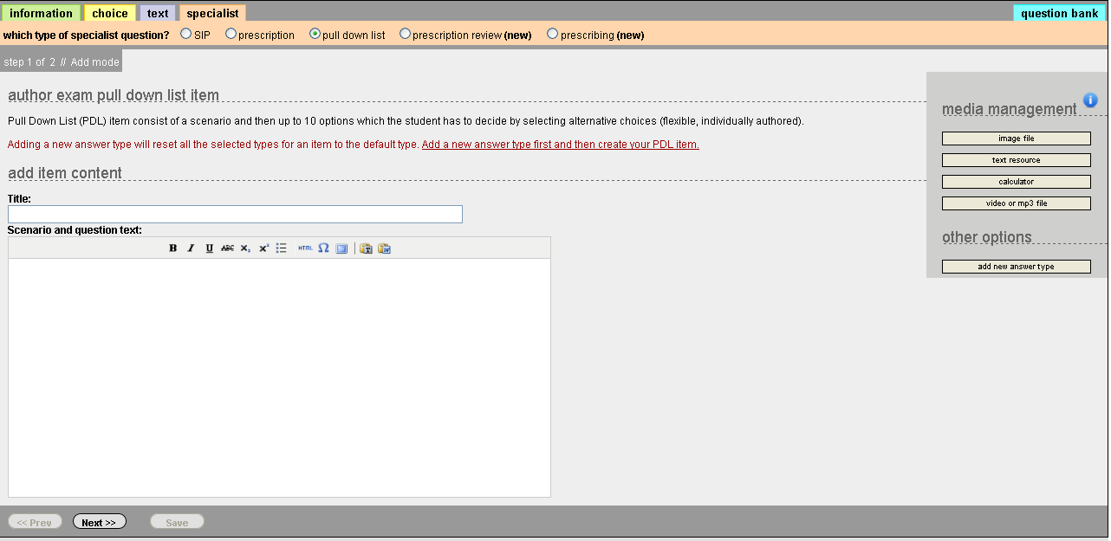
Pull Down List: Enter title and scenario

Slide 58
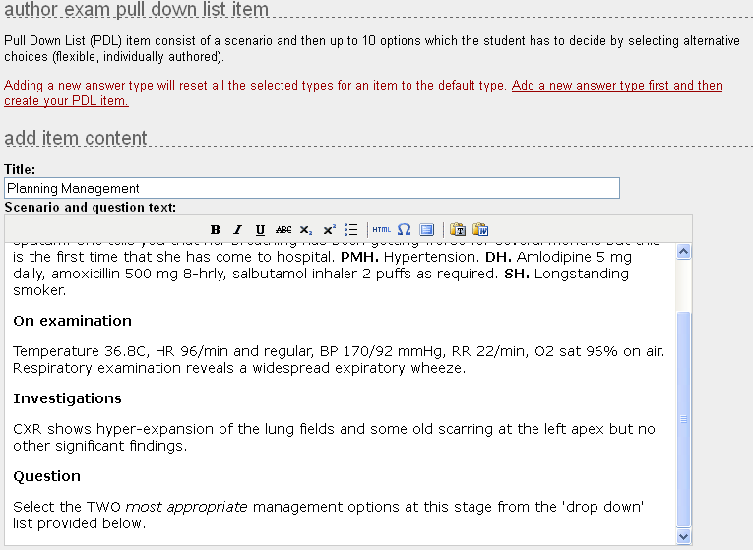
Pull Down List: Example title and scenario

Slide 59
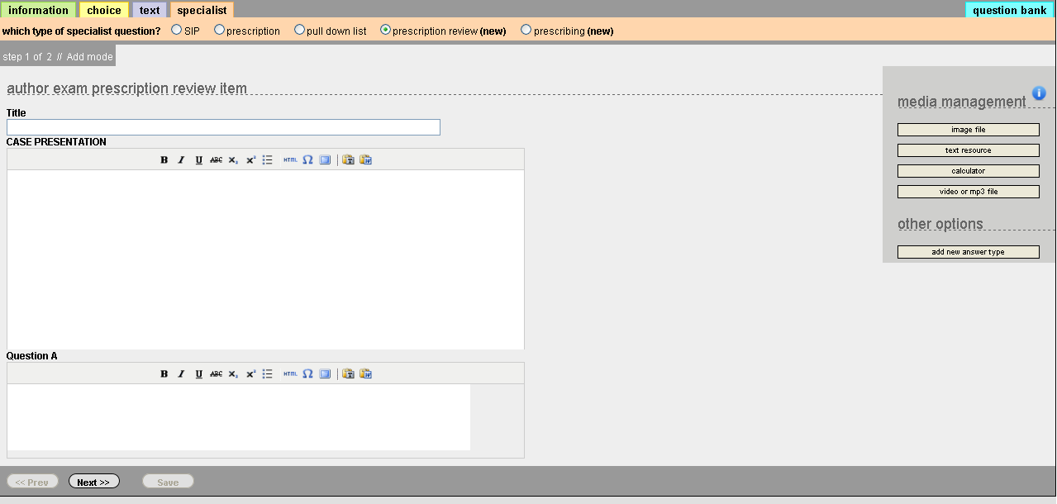
Prescription Review: Enter Title, Case Presentation and Questions

Slide 60
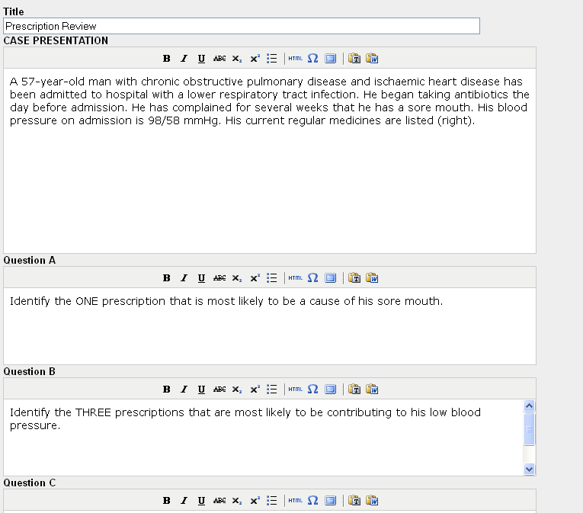
Prescription Review: Example presentation and questions

Slide 61
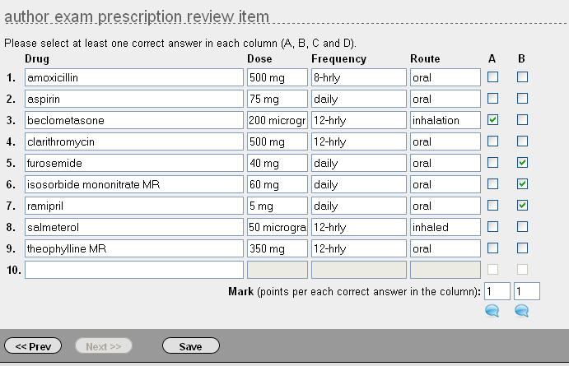
Prescription Review: Possible answers and marks for correct answers

Slide 62
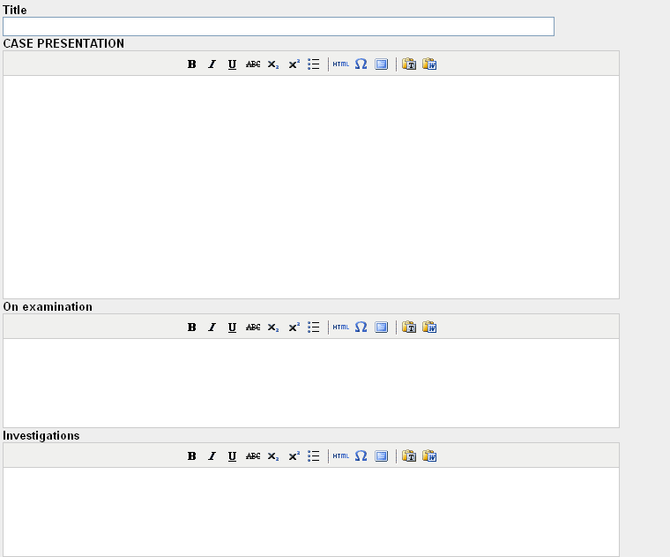
Prescribing: Case Presentation, On Examination and Investigations

Slide 63
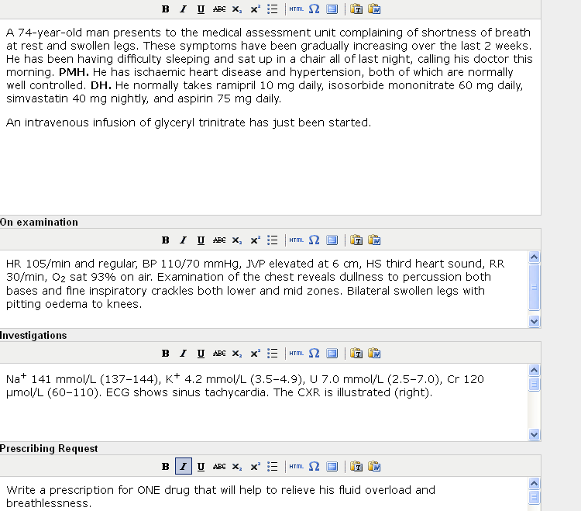
Prescribing: An example scenario

Slide 64
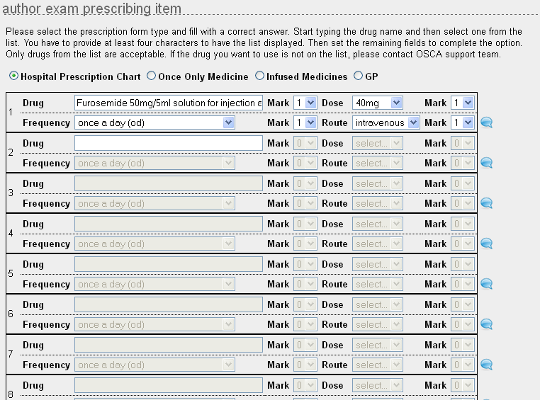
Prescribing: Correct Answer: Drug, Frequency, Dose and Route. Marks are awarded for each. Other options include ‘once only medicine’, ‘infused medicines’ and ‘GP’

Slide 65
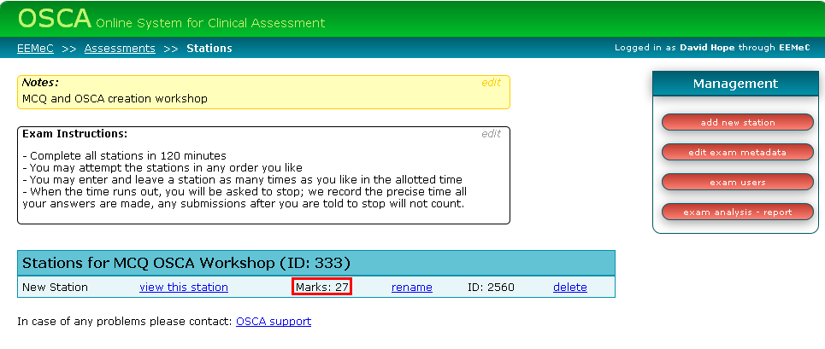
Exam screen: Note marks have been updated to reflect new total

Slide 66
Feedback Mode
Add feedback via speech bubbles
Once the exam is finished and marked LTS can amend the link to the exam so students accessing it will see the exam in feedback mode
This tells them
  Whether they got it right or wrong
  Why

Slide 67
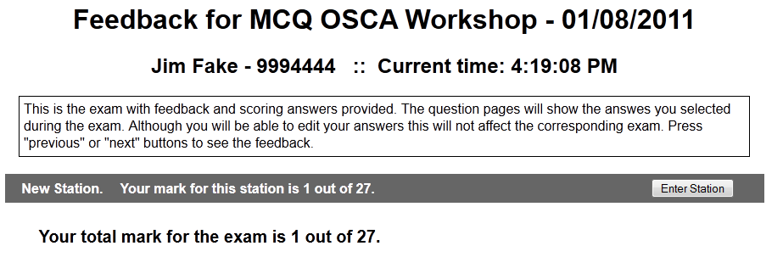

Slide 68
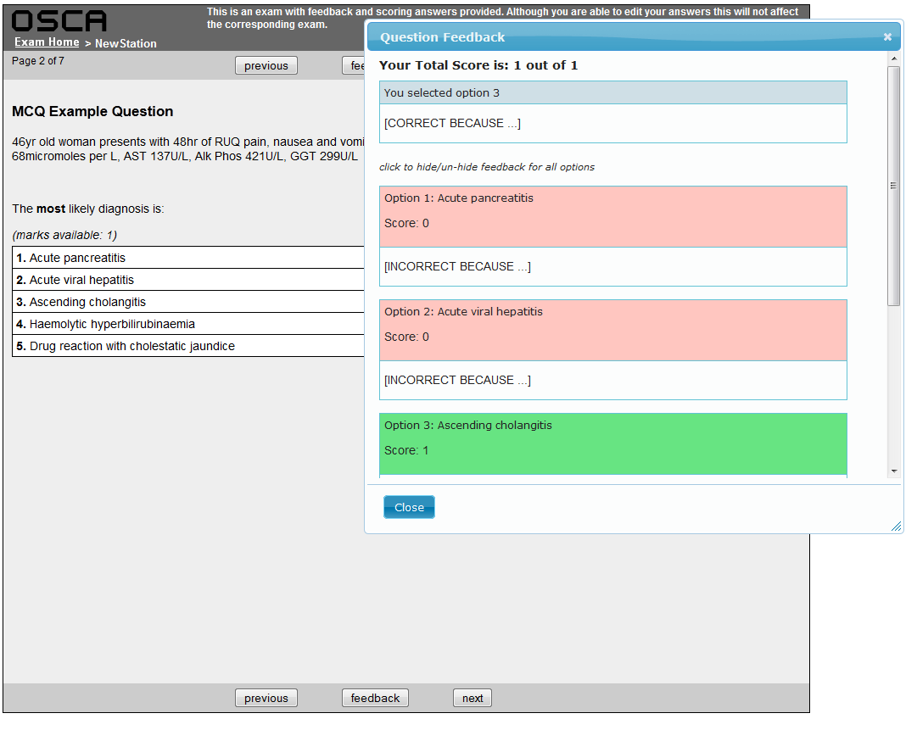

Slide 69
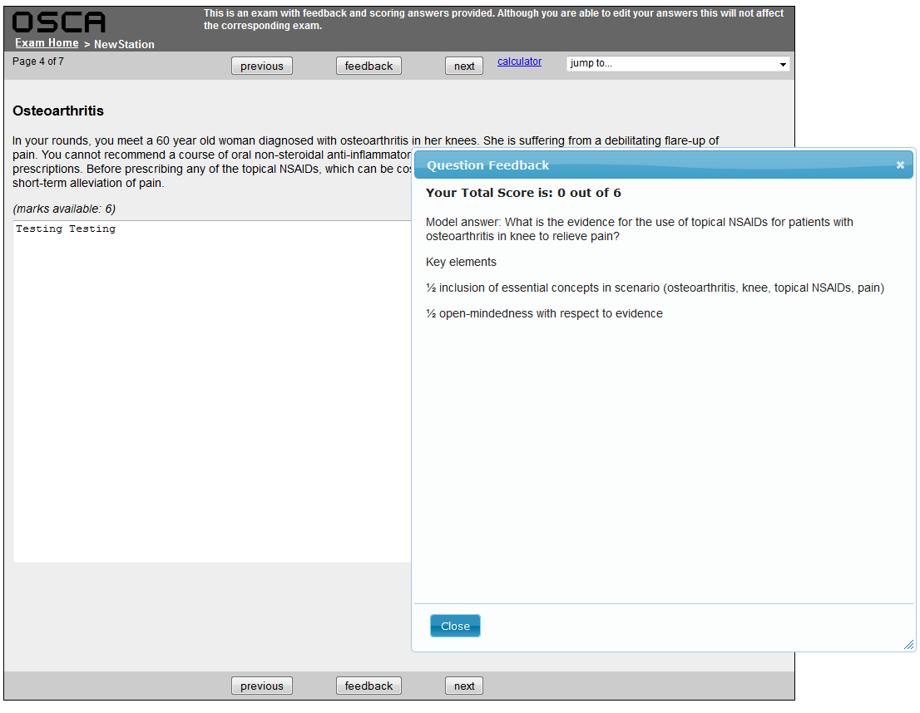

Slide 70
Exam Management
Exams should be considered finished two weeks ahead of the exam data
After this point they go into lockdown
NO modifications or changes should take place after lockdown

Slide 71
Problems and Feature Requests
If you identify errors or want features added
Email me (david.hope@ed.ac.uk)
Or email the support team (osca@lists.ed.ac.uk)
If feasible we will implement the request

