Slide 1
How to put lectures online
SEFCE Symposium
Rob Waller, Ross Ward
6th November 2012

Slide 2
Rationale
Rob
Flipped Classroom
  Keeping the expert for the deep learning
Get the superficial learning out of the way first
  Remember: discover, locate, search, observe, listen
  Evaluate: judge, decide, recommend, annotate
Pedagogy
  Distance Learning
  Revision
  Repetition

Slide 3
Learning Environments
Clinical Environment | Bedside, Clinic, WPBA
Direct Teaching | Lecture, Small Group
Personal Study | PDP, Past papers
Online - unmoderated | Free text, +/- links, PowerPoint Recording, BMJ module Labyrinth Maze
Online - moderated | Forums, Live Chatter Group Blogs / Wikis
Rob

Slide 4
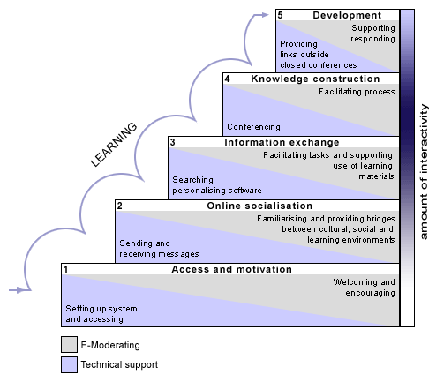
The 5 stages of e-Moderation
Access and Motivation
Online Socialisation
Information Exchange
Knowledge Construction
Learning Community
Learn More…
  Gilly Salmon
Rob

Slide 5
Your experience so far
Share your knowledge and experience of putting lectures on line in any form
Written notes
PowerPoint
Recording
Videoing
Small Groups
Rob

Slide 6
The good online lecture
Draw a rough blueprint of your course
What will work best in different learning environments?
Have you got a lecture in mind?
  Brainstorm this…
Clinical Environment
Direct Teaching
Personal Study
Online - unmoderated
Online - moderated
Small Groups
Rob

Slide 7








What goes into an online lecture?
Ross
Notes:
Getting the lecture experience online
Slides
Voice
Head and Shoulders, Video of presenter
Interactivity
Pause for reflection, think about the content, Ask a question
Interactive questions (Quizes or Surveys)
Links to other great resources
Images sourced from ClipArt, iconspedia, and wikimedia commons.

Slide 8
What goes into an online lecture?
Some considerations
From our experience, here are some tips…
Online attention spans can be small
  Lots of other distractions
  Break-up long lectures
Think about how the online experience will be different from face-to-face
Script or No-Script
Outcomes from the lecture
Find time to create the materials
  A quiet place away from distractions
Ross
Notes:
Tips from our experience of helping people record their presentations

Slide 9
What are the benefits?
Pros
Cons
Easy access
Reviewable
  Pause & Rewind
Reusable
Flip the classroom
Technological factors
Some additional effort to begin with
Ross

Slide 10





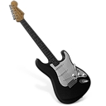









Technologies that are available
Hard
Adobe Connect
Labyrinth
Blackboard Collaborate
Camtasia
Jing
Garageband
Articulate
Presenter / Breeze
Windows Movie Maker
Audacity
iMovie
Articulate
Presenter / Breeze
Slideshare
Smartphone
Survey Monkey
PowerPoint
Easy
Slides Only
Audio Only
Slide & Audio
Interactivity
Screencasts
Virtual Classrooms
Video Editing
Ross
Notes:
A selection of the different technologies available,
As the complexity of the task grows the harder the process becomes (within reason)
The elements in the middle of the chart show the key areas that are the most relevant to online lectures, and are the tools that we will look at the most.

Slide 11
Some examples…
Adobe Presenter (Breeze)
  GPST - Psychopharmacology
Camtasia
  Ophthalmology - Signs and Symptoms
Ross

Slide 12
How it’s done
Demo of recording a Breeze (Presenter) presentation
  Volunteer required…
  Choose your material - a 5 slide PowerPoint
    Rob – ABCDE
    Ross – Bond, James Bond
Ross

Slide 13

Getting your lectures seen
You’ve finished your lecture…
what next?
Getting materials online
  VLEs eg EEMeC
  Forth Suite
  Personal websites
  Professional sites
Open Med www.openmed.co.uk
  Freely available medical education resources fpr the developing world
    Collections by specialty
    Can you contribute?
public
private
Ross
Notes:
Arguably the most important part, making sure content sees the light of day
Different formats, different approaches.
Leads to the question of sharing content, etc.
Icons courtesy of iconspedia, all available under free, public or personal use licenses.
http://www.iconspedia.com/

Slide 14
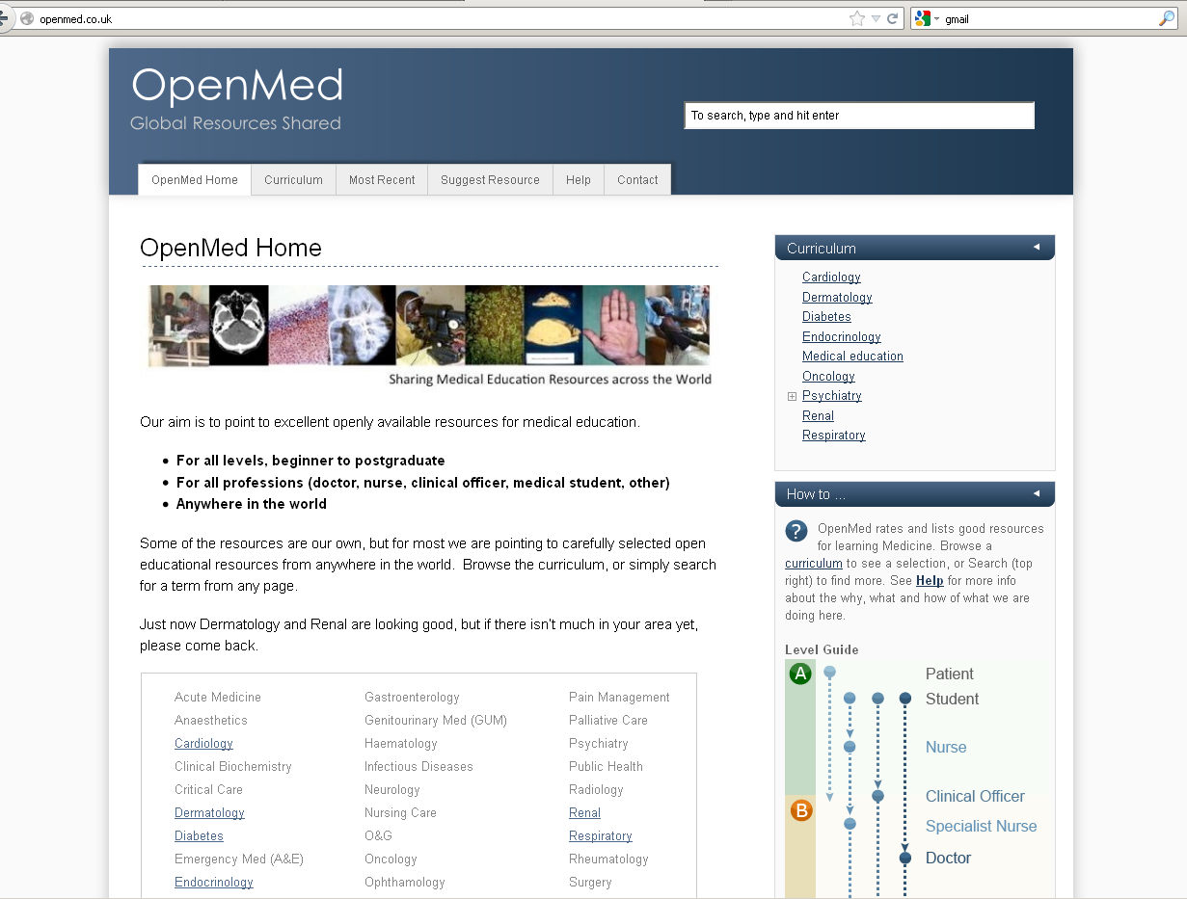

Slide 15
I want to be involved…
Learning Technology Section
Advice on best approaches
Use our “Capture Studio”
  Quiet environment
  Adobe Presenter
  Camtasia
Support from our team
Help with getting files online
Free to use for undergraduate teaching in MVM
Other projects can be quoted on a case by case basis
http://lts.mvm.ed.ac.uk/
http://www.hub.mvm.ed.ac.uk/camtasia/
Ross
Notes:
Overview of LTS services

Slide 16





I want to be involved…
Do It Yourself
Some free software
  Jing (limited use)
Trial software available
  Camtasia
  Articulate
Software you might already have
  Apps for Smartphones
  Garageband
Ross
Notes:
Thoughts about what you need to have a go for yourself, in your own time.
Please ask us at LTS if you have any questions. Remember it can be a long process, so give yourself plenty of time to create these materials
Icons courtesy of iconspedia, all available under free, public or personal use licenses.
http://www.iconspedia.com/

Slide 17
Give it a go….

Slide 18
Links and Details
Ross Ward
  ross.ward@ed.ac.uk
Rob Waller
  rob.waller@nhslothian.scot.nhs.uk
Learning Technology Section
  http://www.lts.mvm.ed.ac.uk
  http://www.hub.mvm.ed.ac.uk/camtasia/

